Slide 1
CREATING A GRC GRILL we are the privileged few with the choice in creating things differently
SRIHARI NILKAR
PUNE

Slide 2
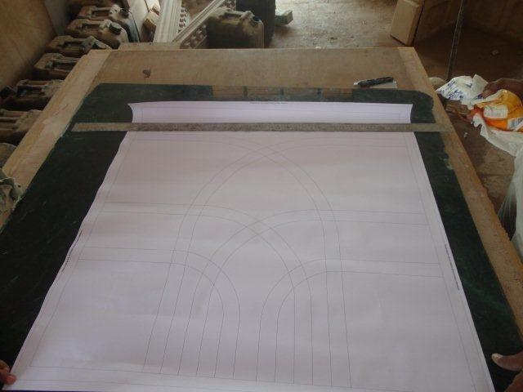
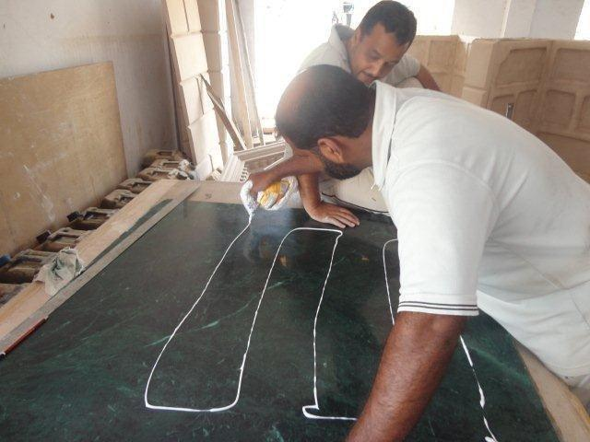
THE 1:1 CAD DETAIL OF THE JALI

Slide 3
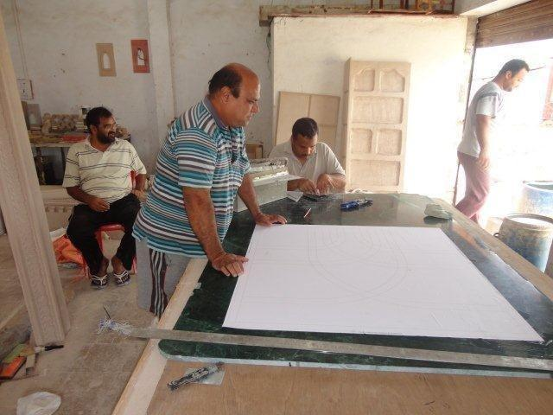
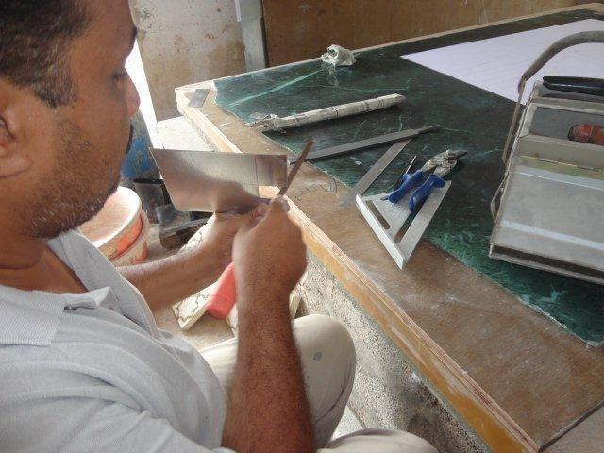
THE FIRST STEP TO THE PATTERN MAKING

Slide 4
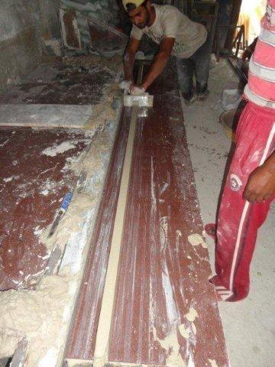
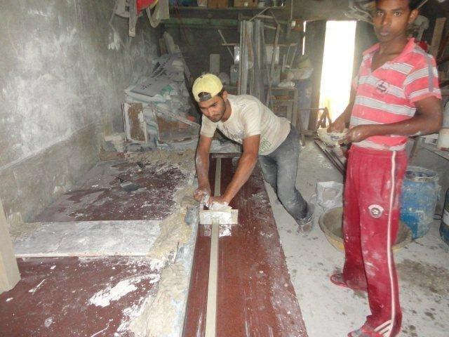
THE DESIRED PATTERN PROFILES BEING CREATED ON POP

Slide 5
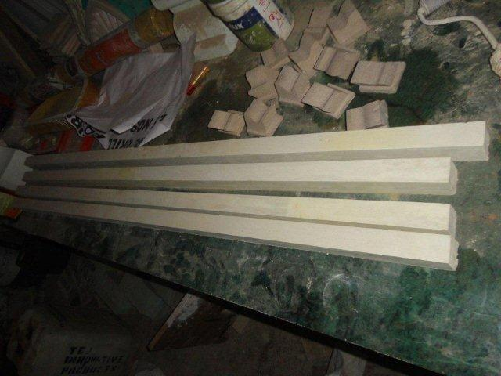
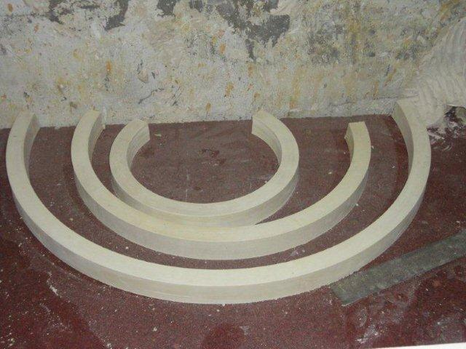
THE DIFFERENT PROFILES CREATED FOR THE JALI

Slide 6
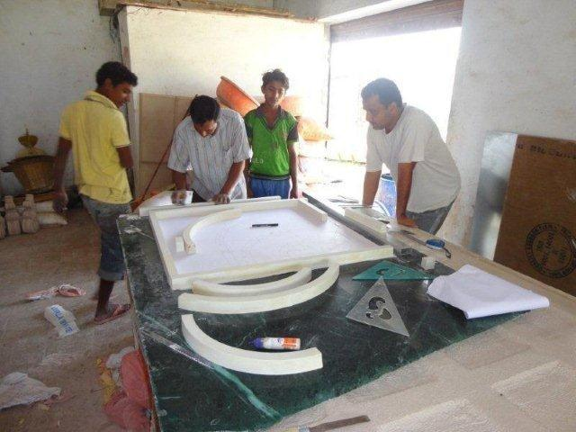
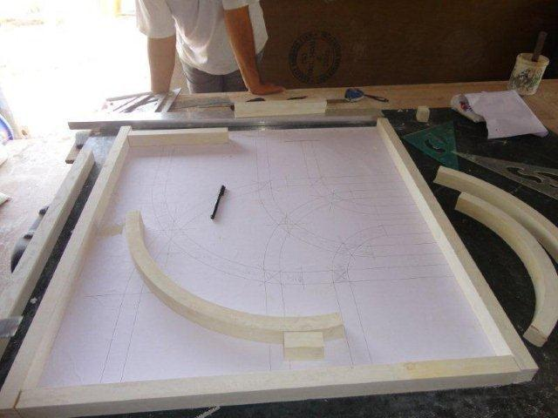
CUTTING & SIZEING AS PER THE DETAIL

Slide 7
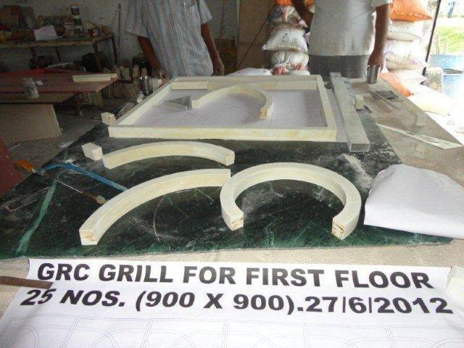
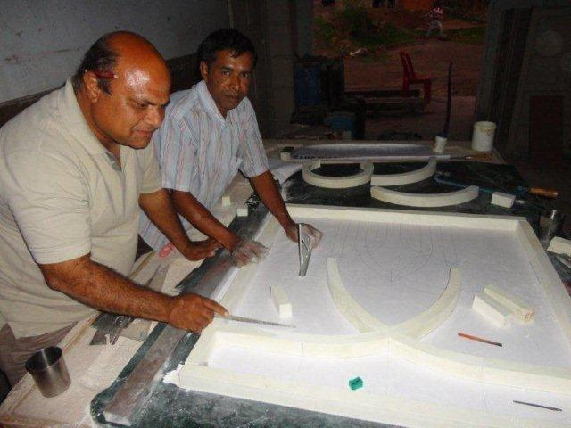
CUTTING & SIZEING AS PER THE DETAIL

Slide 8
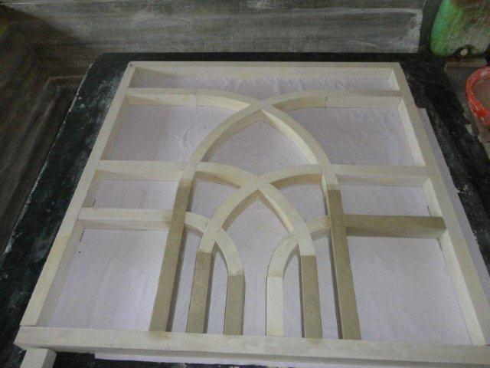
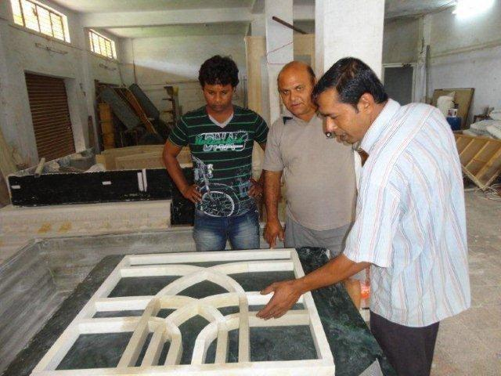
THE GRC PATTERN CREATED AS PER DETAIL PROVIDED

Slide 9
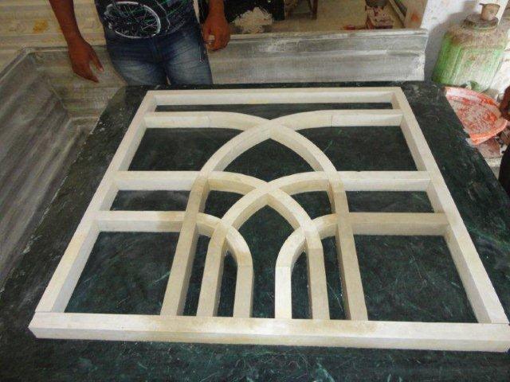
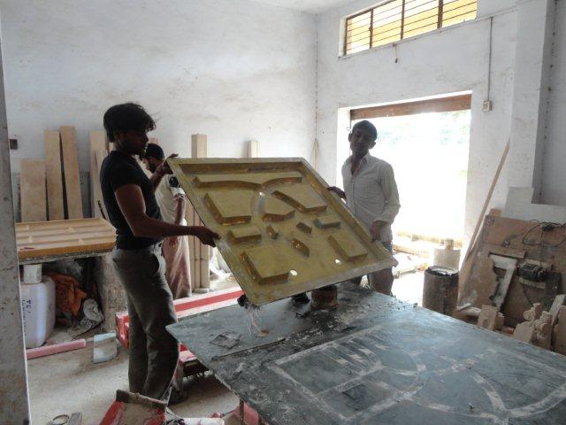
THE PATTERN & THE FRP BACK MOLD

Slide 10
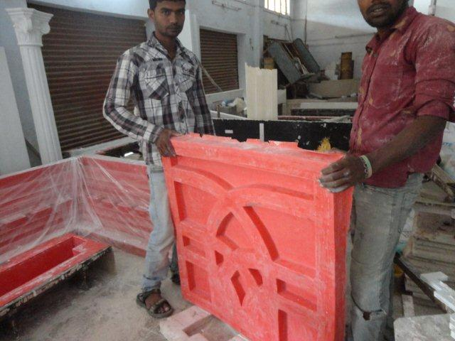
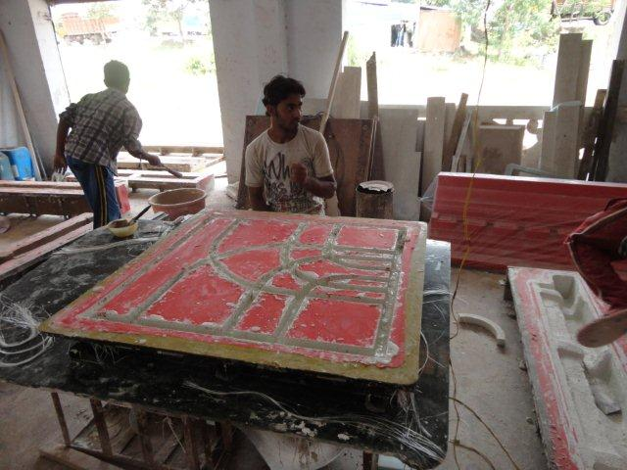
THE RUBBER MOLD & GRILL CASTING

Slide 11
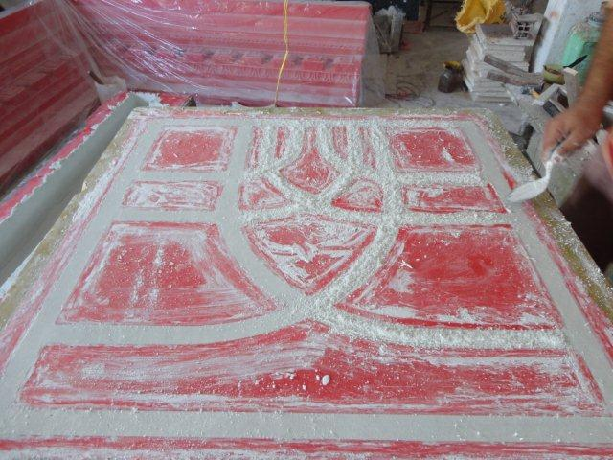
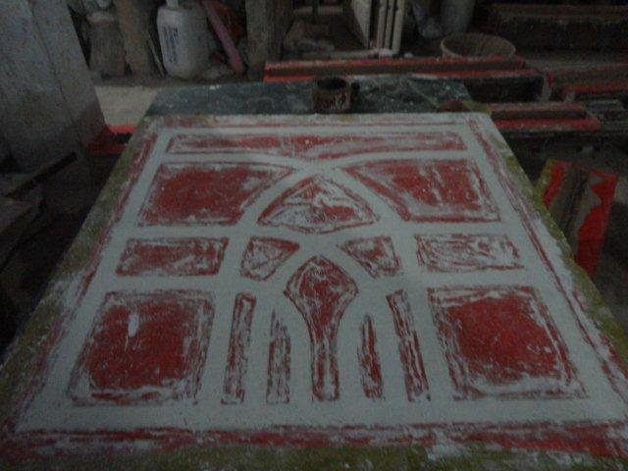
THE FINAL FINISHING OF THE CASTED ELEMENT

Slide 12
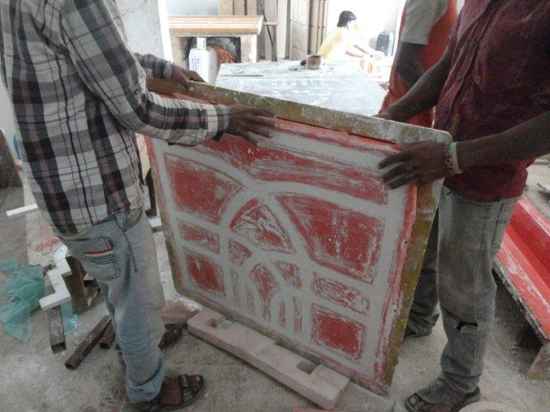
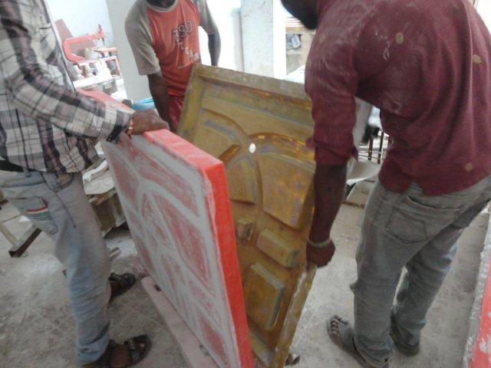
THE DEMOLDING OF THE ELEMENT

Slide 13
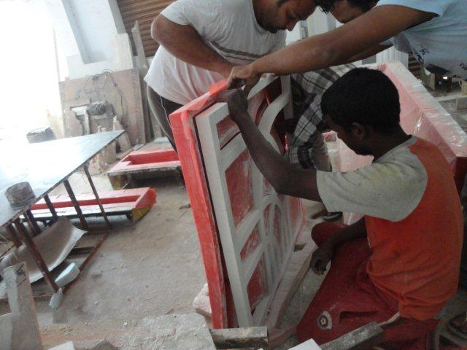
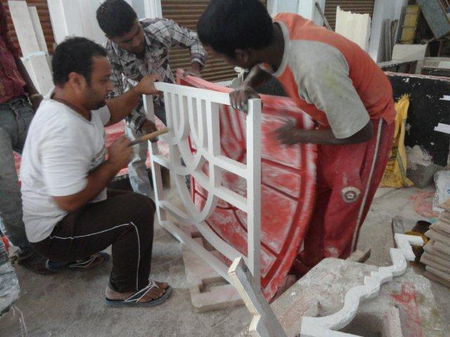
THE DEMOLDING OF THE ELEMENT

Slide 14
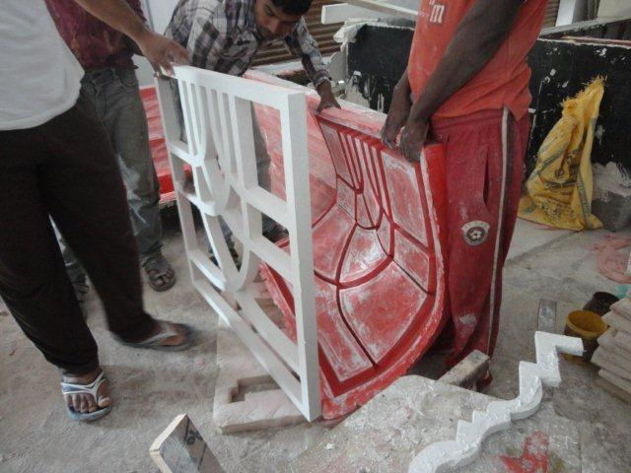
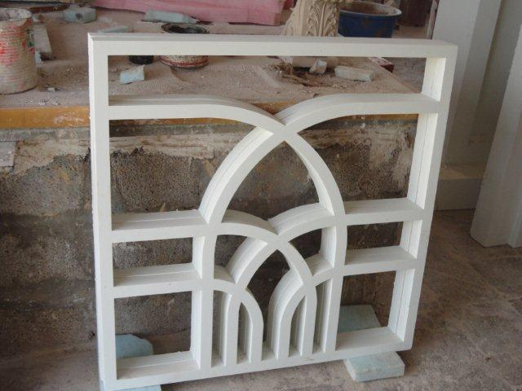
THE DEMOLDING OF THE ELEMENT

Slide 15
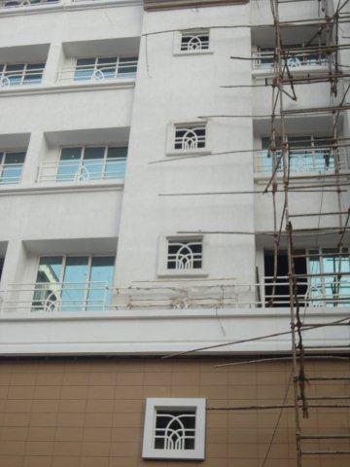
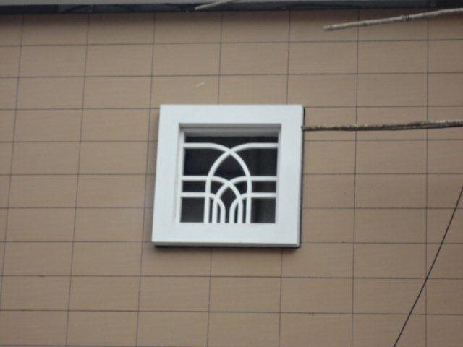
THE JALI INSTALLED AT SITE

Slide 16
CONTACT US -
GFRC FACADES.
GFRC / GRC, GRG CEILINGS & PANELS, FRP WORKS, HIGH END DECORATIVE & ARCHITECTURAL WORKS & ACOUSTIC SOLUTIONS WITH EXPERTISE IN HOME THEATRES
SRIHARI NILKAR
MUMBAI
Mobile: 09867569395
nilkarsrihari@gmail.com

